Slide 1
Capstone Engagement
Assessment, Analysis, and Hardening of a Vulnerable System

Slide 2
Table of Contents
This document contains the following sections:
01
Network Topology
02
Red Team: Security Assessment
03
Blue Team: Log Analysis and Attack Characterization
Hardening: Proposed Alarms and Mitigation Strategies
04

Slide 3
Network Topology
‹#›

Slide 4
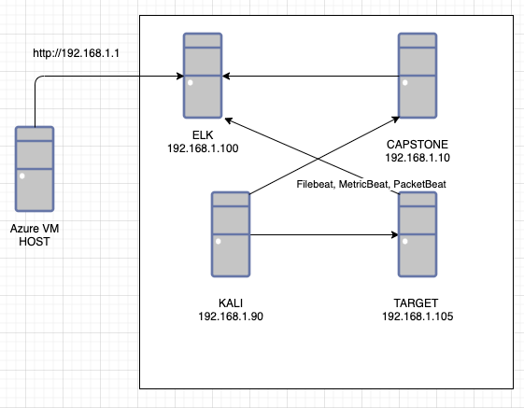
Network Topology
[Insert Here]
Use draw.io to create a diagram of the network.
Add your diagram to this slide and fill out the data in the sidebar.
Network
Address Range: 192.168.1.0/24
Netmask: 255.255.255.0
Gateway: 192.168.1.1
Machines
IPv4: 192.168.1.100
OS: Linux
Hostname: ELK
IPv4: 192.168.1.90
OS: Linux
Hostname: Kali
IPv4: 192.168.1.105
OS: Linux
Hostname: Target 1
IPv4: 192.168.1.110
OS: Linux
Hostname: Capstone

Slide 5

Red Team
Security Assessment
‹#›

Slide 6
Recon: Describing the Target
DIRB identified the following hosts on the network:
Hostname | IP Address | Role on Network
ELK | 192.168.1.100 | ELK Server
Capstone | 192.168.1.110 | Test Alerts
KALI | 192.168.1.90 | Attacking Machine
TARGET MACHINE | 192.168.1.105 | Target Machine

Slide 7
Vulnerability Assessment
ELK
The assessment uncovered the following critical vulnerabilities in the target:
Vulnerability | Description | Impact
Unsalted Hashes | Used Crackstation to find the correlating hash to user password. | Unsalted hashes made them easy to crack with Crackstation
Open Ports | NMAP allows for an open scan to see what ports are open on the network | Once open ports are detected then we can SSH into those ports
HYDRA Brute Force | Brute force attack that allows for multiple password attempts | Able to crack password after attack

Slide 8
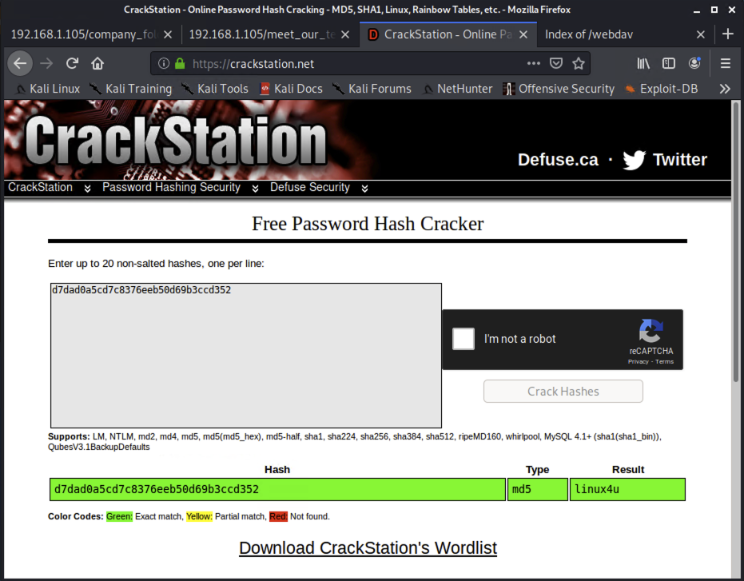
Exploitation: Unsalted Hashes
01
02
03
Tools & Processes
How did you exploit the vulnerability?
By running Crackstation, the hashed passwords were easily deciphered.
Achievements
What did the exploit achieve?
Gave password access

Slide 9
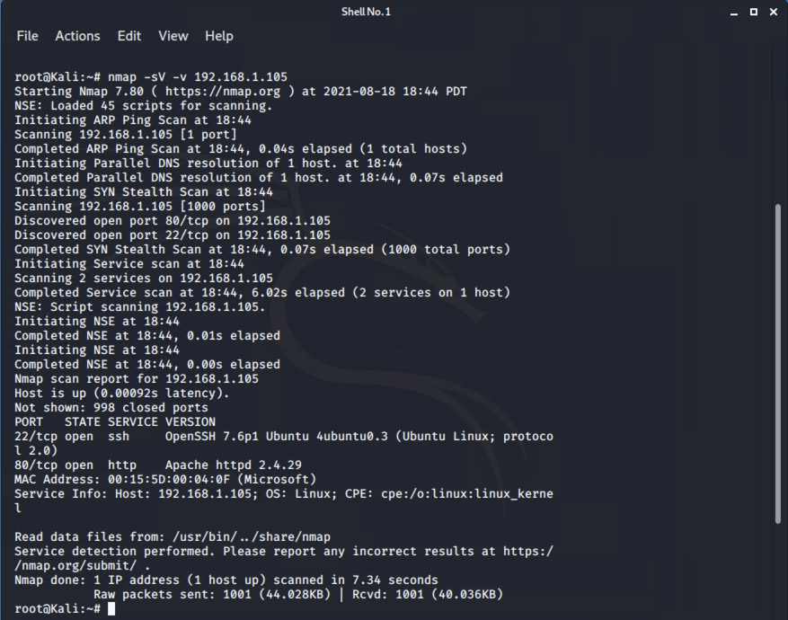
Exploitation: Open Ports
01
02
03
Tools & Processes
How did you exploit the vulnerability?
With open ports, scanning tools like nmap allowed to see which port to attack.
Achievements
Ability to gain access to ports and servers
[INSERT: screenshot or command output illustrating the exploit.]

Slide 10
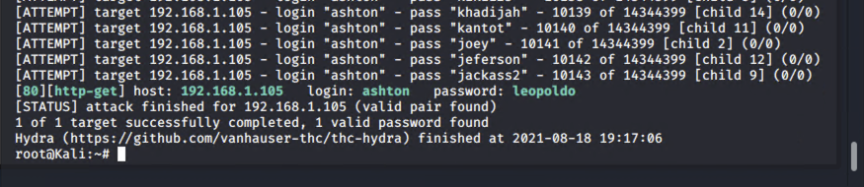
Exploitation: HYDRA Brute Force
01
02
03
Tools & Processes
How did you exploit the vulnerability?
HYDRA allowed for a brute force that inputted several passwords within milliseconds.
Achievements
What did the exploit achieve?
Allowed for the password to be detected.

Slide 11

Blue Team
Log Analysis and Attack Characterization
‹#›

Slide 12

Analysis: Identifying the Port Scan
Answer the following questions in bullet points under the screenshot if space allows. Otherwise, add the answers to speaker notes.
What time did the port scan occur?
How many packets were sent, and from which IP?
What indicates that this was a port scan?
[Insert Here]
Include a screenshot of Kibana logs depicting the port scan.

Slide 13
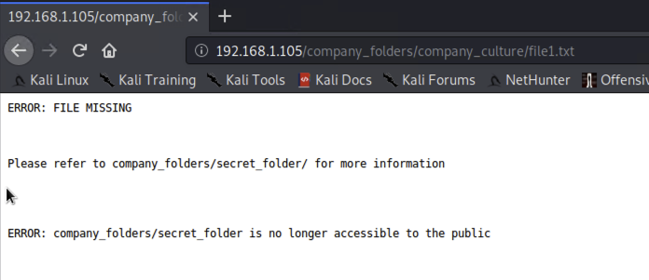
Analysis: Finding the Request for the Hidden Directory
Answer the following questions in bullet points under the screenshot if space allows. Otherwise, add the answers to speaker notes.
What time did the request occur? How many requests were made?
Which files were requested? What did they contain?
[Insert Here]
Include a screenshot of Kibana logs depicting the request for the hidden directory.

Slide 14
Analysis: Uncovering the Brute Force Attack
Answer the following questions in bullet points under the screenshot if space allows. Otherwise, add the answers to speaker notes.
How many requests were made in the attack?
How many requests had been made before the attacker discovered the password?
[Insert Here]
Include a screenshot of Kibana logs depicting the brute force attack.

Slide 15
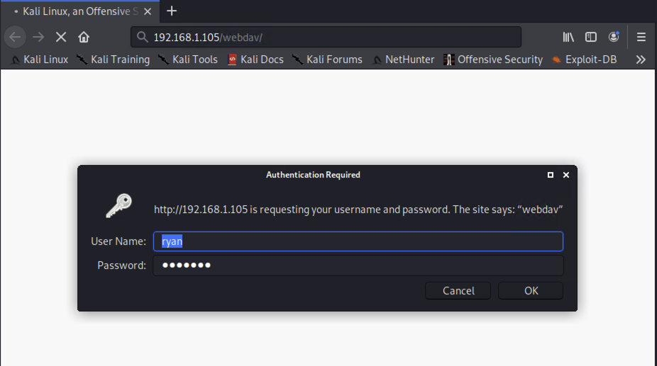
Analysis: Finding the WebDAV Connection
Answer the following questions in bullet points under the screenshot if space allows. Otherwise, add the answers to speaker notes.
How many requests were made to this directory?
Which files were requested?
[Insert Here]
Add a screenshot of Kibana logs depicting the WebDAV connection.

Slide 16
Blue Team
Proposed Alarms and Mitigation Strategies
‹#›

Slide 17
Mitigation: Blocking the Port Scan
What kind of alarm can be set to detect future port scans?
Alert for when port 4444 has been pinged and accessed.
What threshold would you set to activate this alarm?
Any ping or confirmed access
What configurations can be set on the host to mitigate port scans?
Configurations would be set specifically for port 4444
Describe the solution. If possible, provide required command lines.
Solution would be to block access to port 4444

Slide 18
Mitigation: Finding the Request for the Hidden Directory
What kind of alarm can be set to detect future unauthorized access?
Alert set for when secret file directory is accessed after hours.
What threshold would you set to activate this alarm?
Time frame of weekends and after hours
What configuration can be set on the host to block unwanted access?
Time limit configuration
Describe the solution. If possible, provide required command lines.
Time limited to a specific time during working hours. Any access outside of that window will cause an alert.

Slide 19
Mitigation: Preventing Brute Force Attacks
What kind of alarm can be set to detect future brute force attacks?
When multiple login attacks happen within a few seconds, then send alert.
What threshold would you set to activate this alarm?
5 attempts will be allowed per day.
What configuration can be set on the host to block brute force attacks?
Set a limit of allowed attempts to gain access.
Describe the solution. If possible, provide the required command line(s).
Allowing for up to 5 attempts then a prompt to reset the password will prevent hundreds of attempts at once.

Slide 20
Mitigation: Detecting the WebDAV Connection
What kind of alarm can be set to detect future access to this directory?
Alert whenever WEBDAV login occurs.
What threshold would you set to activate this alarm?
Whenever any access to the WebDAV protocol, send alert.
What configuration can be set on the host to control access?
Configuration for completed login to WEBDAV
Describe the solution. If possible, provide the required command line(s).
With an alert, especially after hours, then notification of intrusion will occur.

Slide 21
Mitigation: Identifying Reverse Shell Uploads
What kind of alarm can be set to detect future file uploads?
An alert for all php uploads
What threshold would you set to activate this alarm?
No PHP file uploads
What configuration can be set on the host to block file uploads?
Configuration will be based on file type.
Describe the solution. If possible, provide the required command line.
PHP files create reverse shells. Preventing PHP files will help prevent reverse shell uploads

